Slide 1
TECMIS Interface
Human-Computer Interaction- ICT3152
Group No: 09

Slide 2
Contents
Introduction
Cons of the current system
New Interface design

Slide 3
Introduction
TECMIS is the system for the Faculty of Technology, University of Ruhuna to share the major information with the students and other members
From this system students can do,
View notices
View Results
Register for exams and courses
Order foods

Slide 4
Cons of current system Interface
Not responsive
Cannot find some functions easily
Gulf of execution
No much user friendly

Slide 5
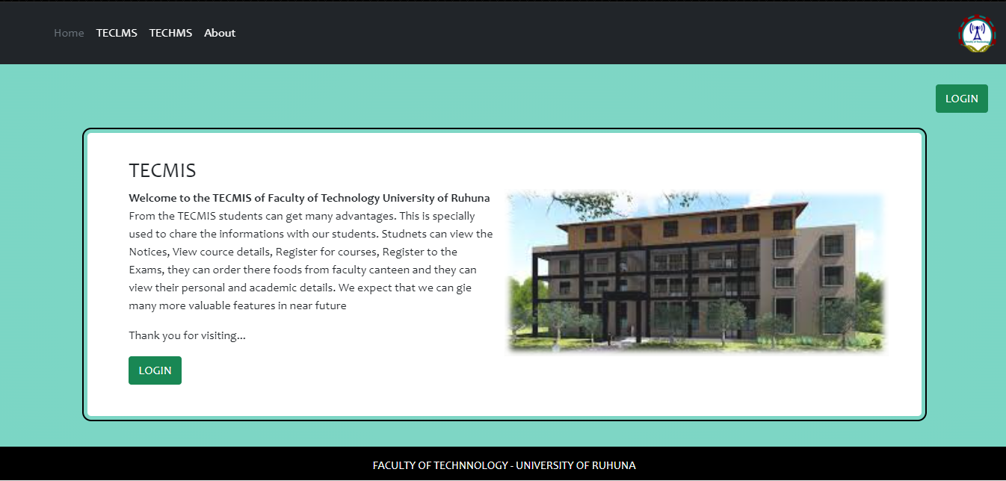
Home Page

Slide 6
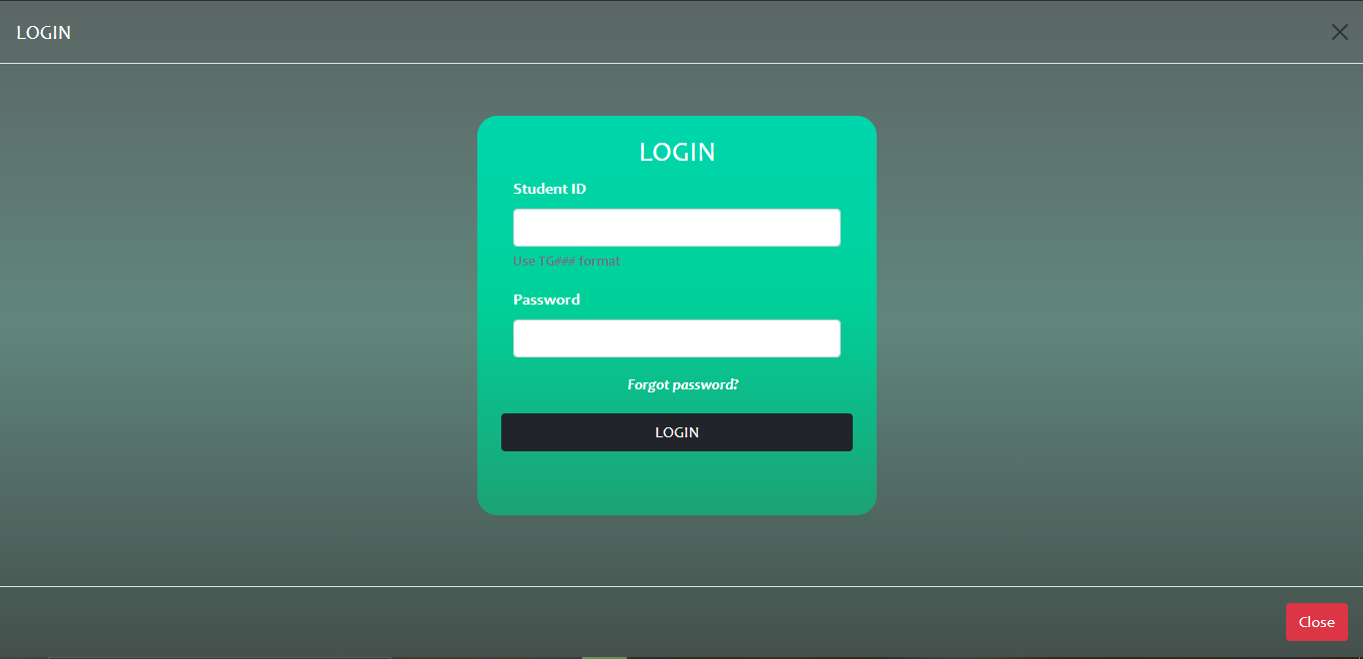
LOGIN page

Slide 7
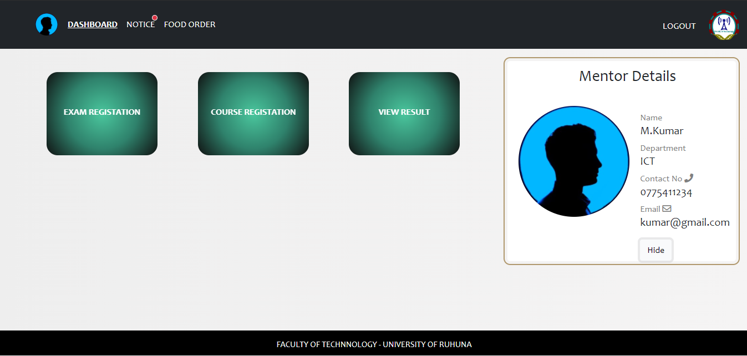
Dashboard

Slide 8
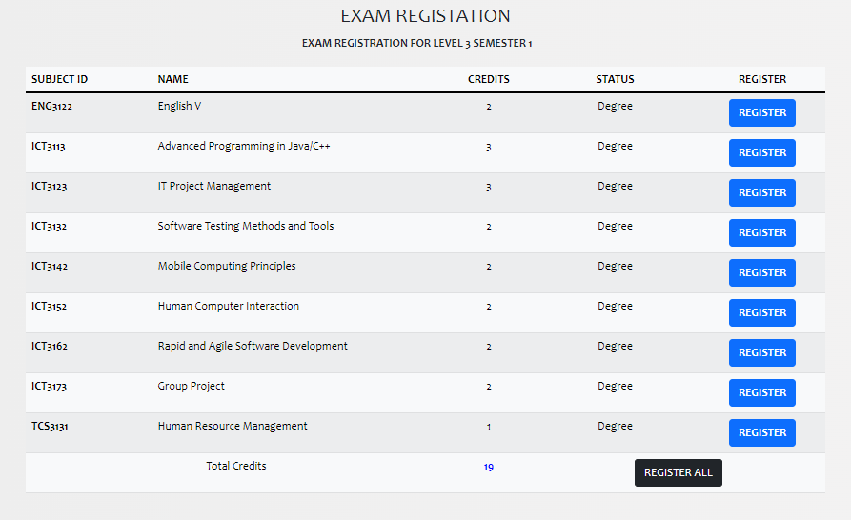
Exam Registrations

Slide 9
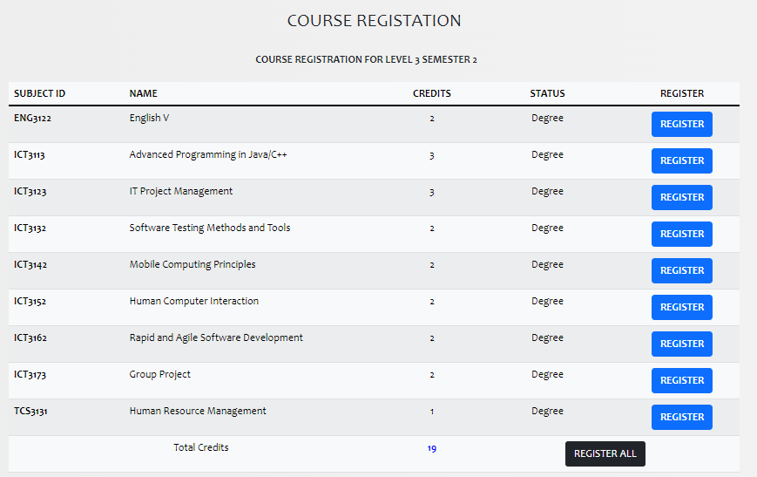
Course Registration

Slide 10
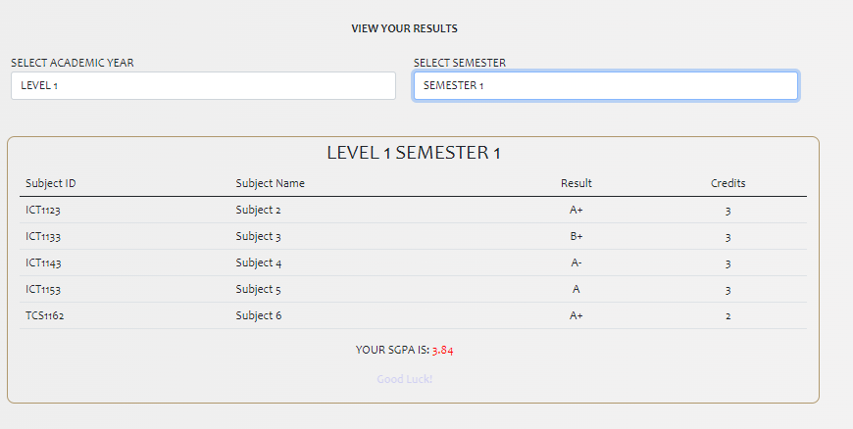
View Results

Slide 11
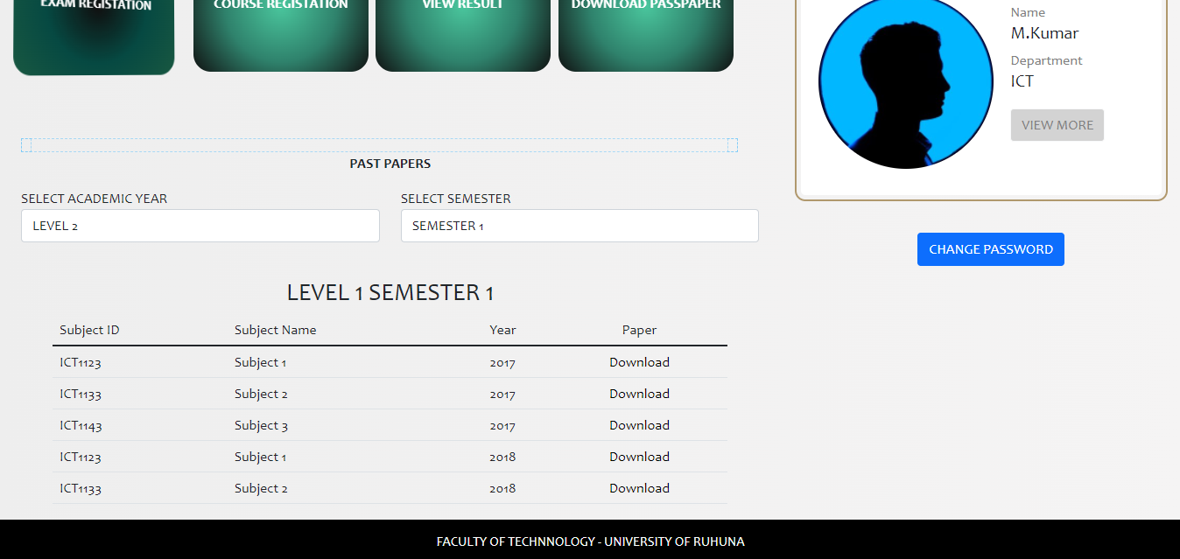
Download past paper

Slide 12
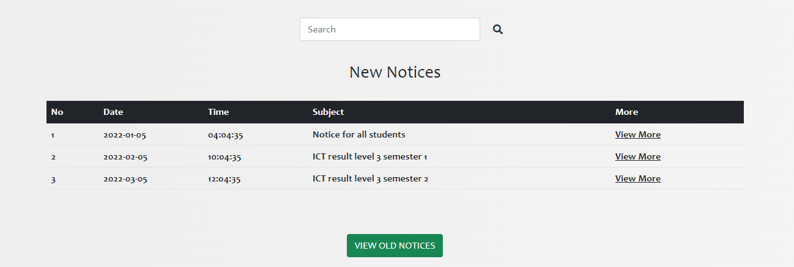
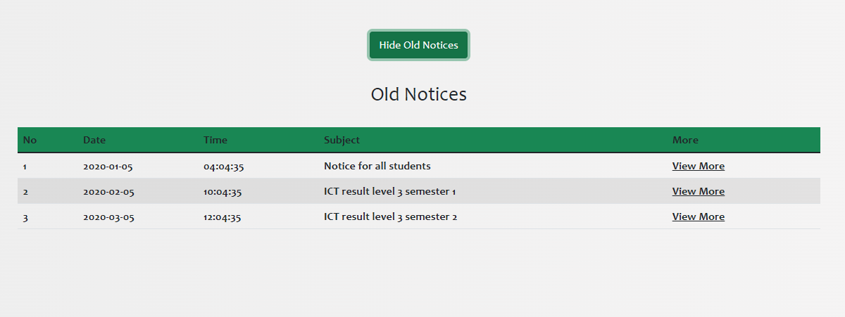
Notice

Slide 13
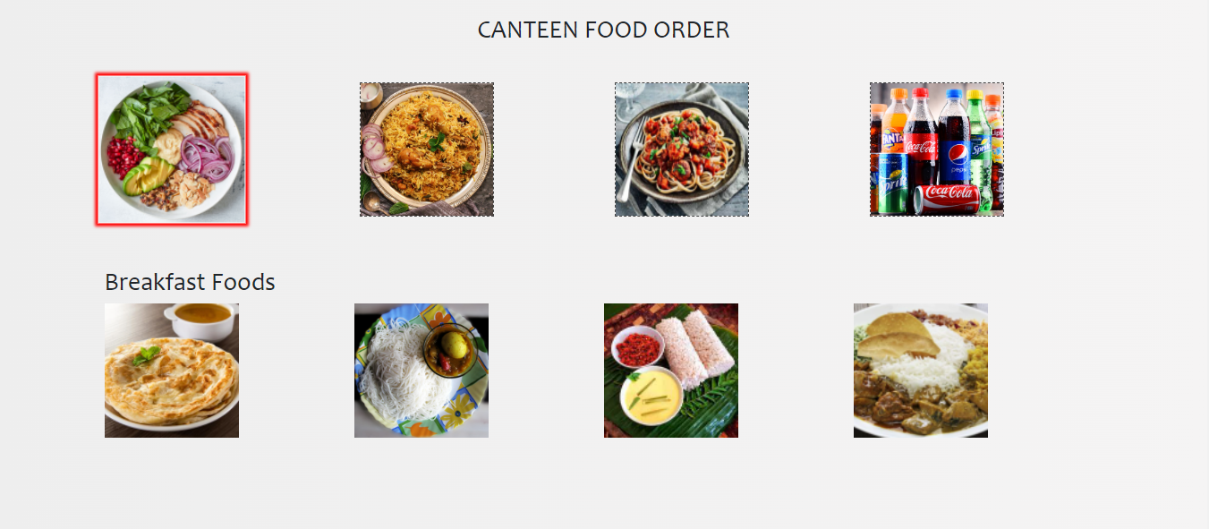
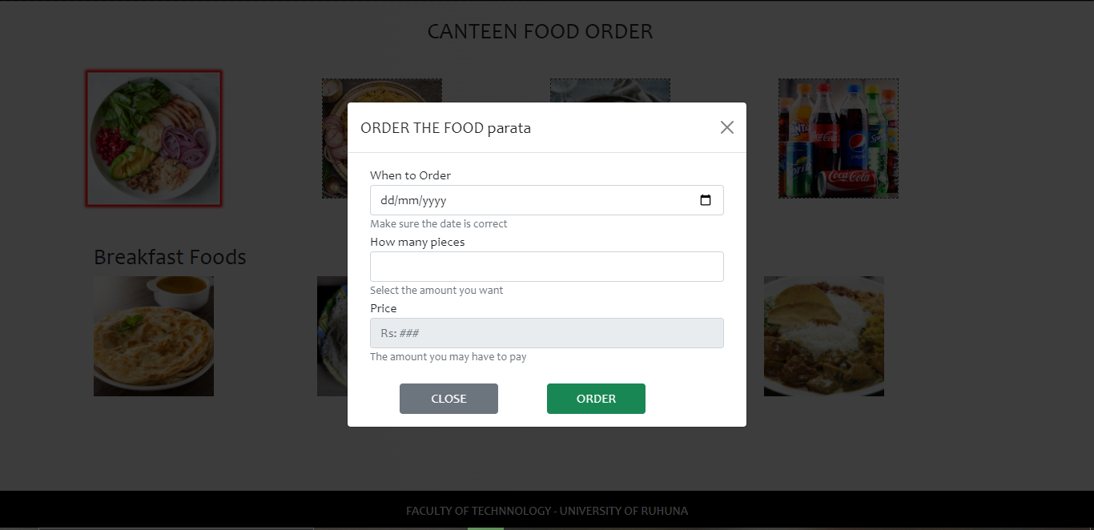
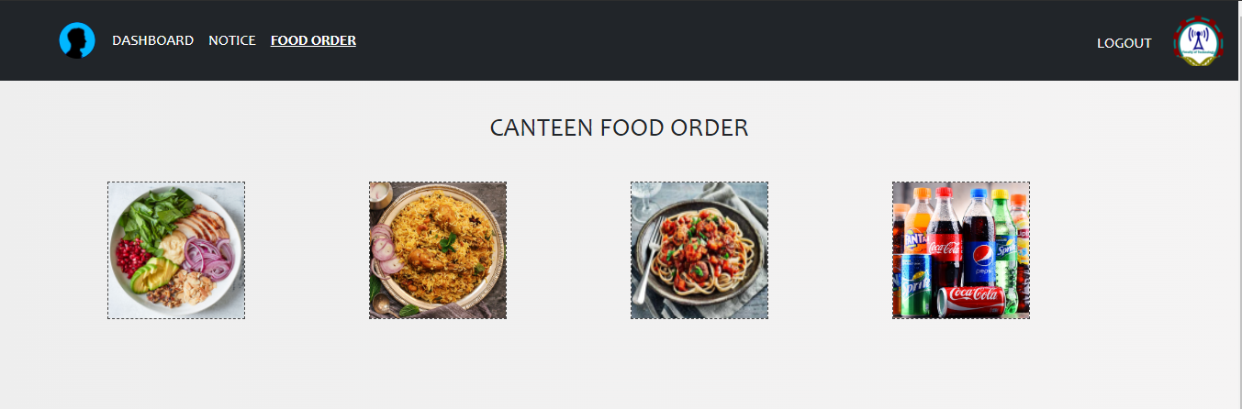
Food Order

Slide 14
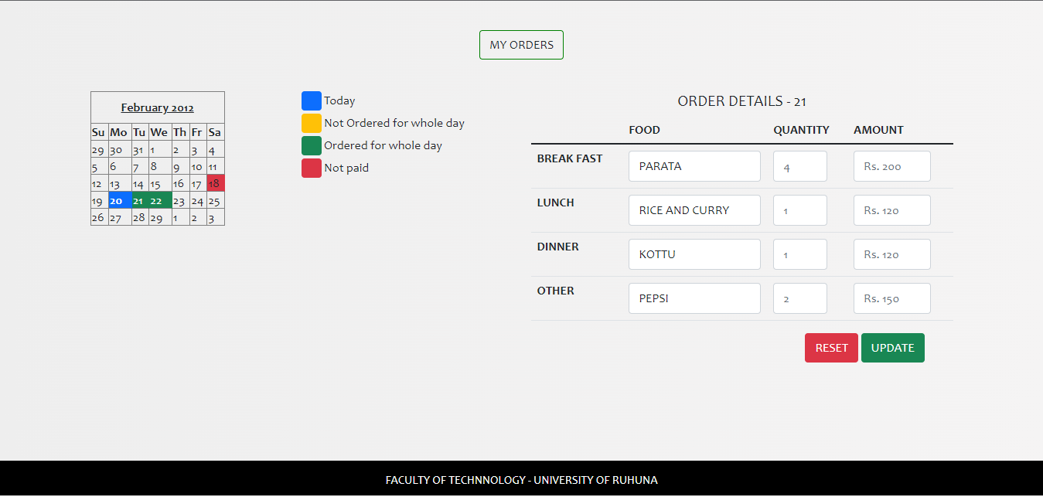
Ordered Foods

Slide 15
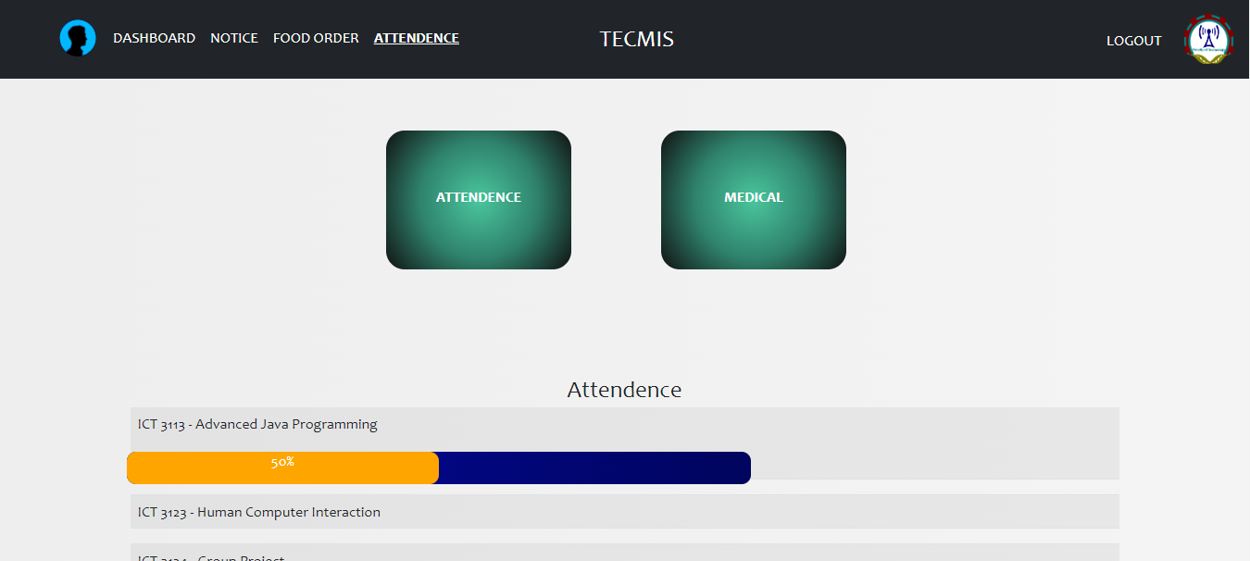
Attendance

Slide 16
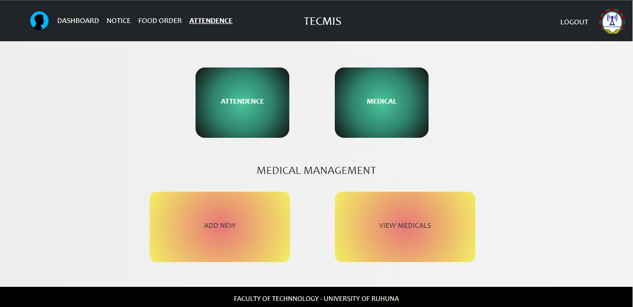
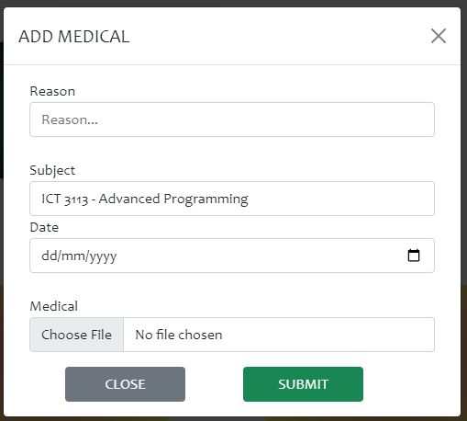
Medical

Slide 17
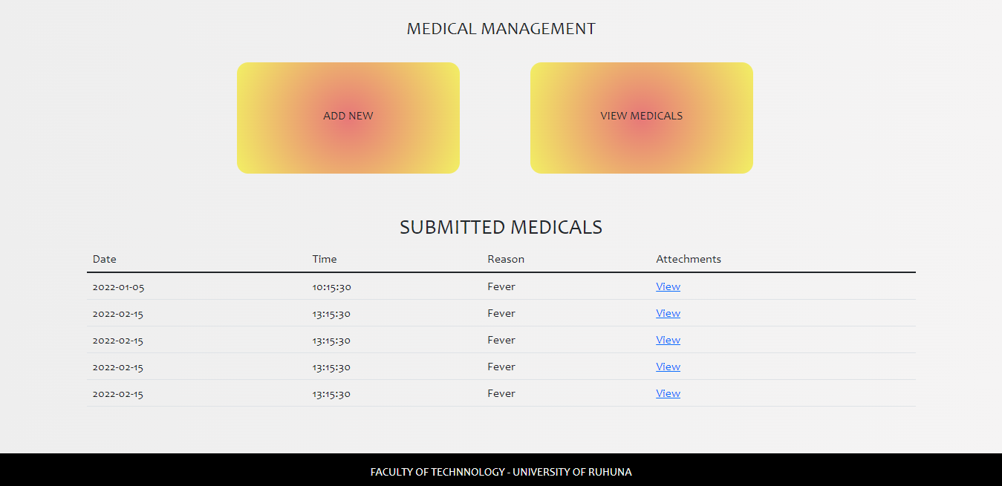
Submitted Medical

Slide 18
Conclusion
We have designed our new design to solve the issues in the current system, Increase user-friendliness and increase the attractiveness of the system

Slide 19

Any Question

Slide 20
Thank you
Group Members
TG/2018/386 – M.R. Muhannadh
TG/2018/399 – Prunthan Y.
TG/2018/407 – Jathukulan S.
TG/2018/410 – Elil Vannan M.

